Slide 1

Quick Quiz
An I-On Project
Progress Update
Participants:
Vitor Mexia 36070
Tiago Carvalho 36080
Supervisor:
Prof. Pedro Félix

Slide 2
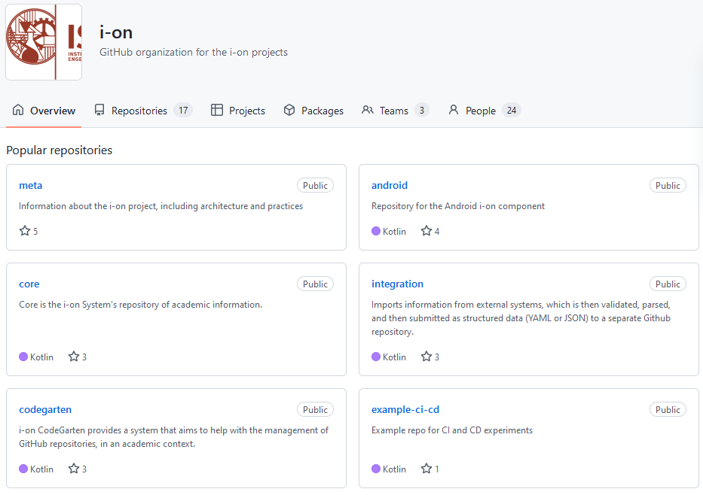
I-On project
Support systems for academic activity
Open Source
Notes:
Quick Quiz is a project to promote the interaction between professors and his students during class by providing a way for a teacher to present questions (quizzes) which the students can then answer anonymously.

Slide 3
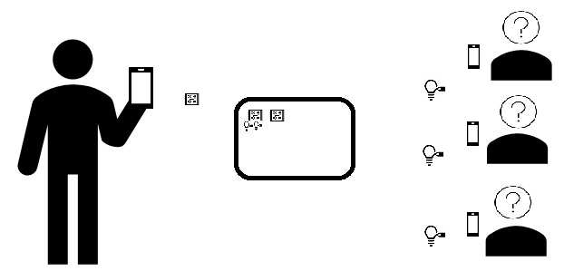
Quick Quiz
Create quiz sessions as a registered user
Support for session templates
Reply to quizzes anonymously
Application abuse prevention
Notes:
Quick Quiz is a project to promote the interaction between professors and his students during class by providing a way for a teacher to present questions (quizzes) which the students can then answer anonymously.

Slide 4
Requirements
Easy and secure authentication
Concept of quiz session
All quizzes answers are anonymous
Notes:
Quick Quiz is a project to promote the interaction between professors and his students during class by providing a way for a teacher to present questions (quizzes) which the students can then answer anonymously.

Slide 5
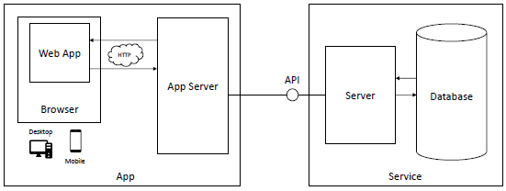
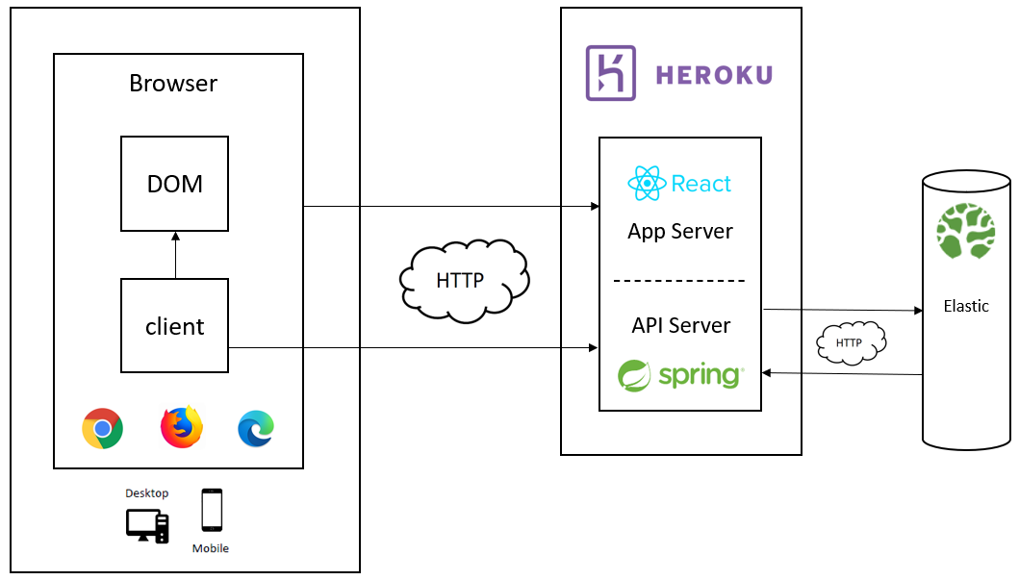
Architecture
Change to proposed architecture
Notes:
Quick Quiz is a project to promote the interaction between professors and his students during class by providing a way for a teacher to present questions (quizzes) which the students can then answer anonymously.

Slide 6

Progress

Slide 7

April 10th to 23rd (week 6 & 7) API Definition and repository structure
Highlights
API endpoints
Elasticsearch data model
API input/output models
Challenges
Spring Boot
Spring Data Elasticsearch
OpenAPI

Slide 8
April 24th to May 13rd (week 8, 9 & 10) API Improvements and Frontend start
Highlights
Redefine response output
Finished remaining API endpoints
Implemented frontend initial design and authentication
Challenges
Problem+JSON
JSON Siren
React

Slide 9
Next Steps

Slide 10
May 15th to 28rd (week 11 & 10) Frontend development
Highlights
Implement all major features in website
Implement websockets
Improve API where needed
Challenges
React
Websockets

Slide 11
May 28th to June 4th (week 12 & 13) Initial Deployment
Highlights
Deploy to Heroku (dev/staging environment)
Prepare demo
Implement extra functionality
Challenges
Heroku
Heroku-Bonsai

Slide 12
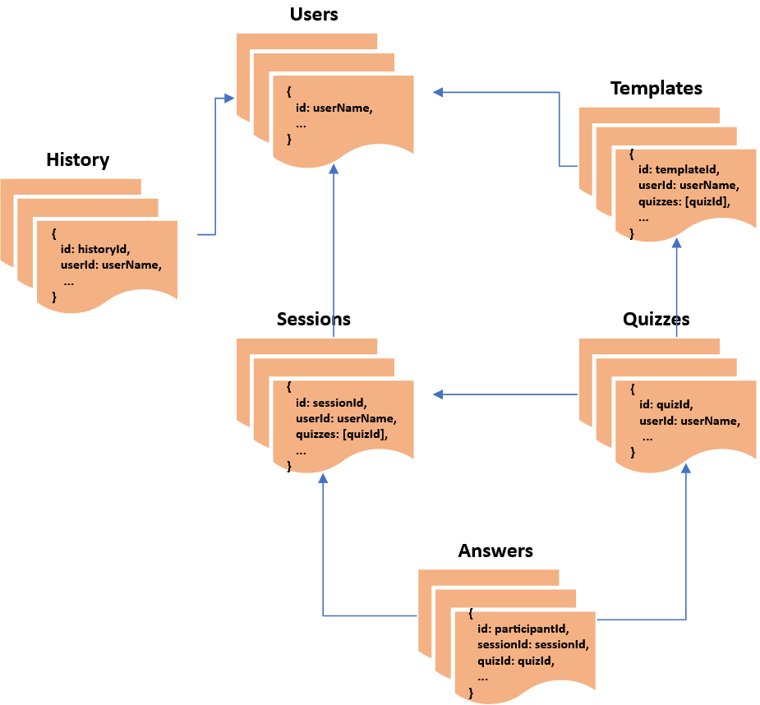
Elasticsearch structure

Slide 13
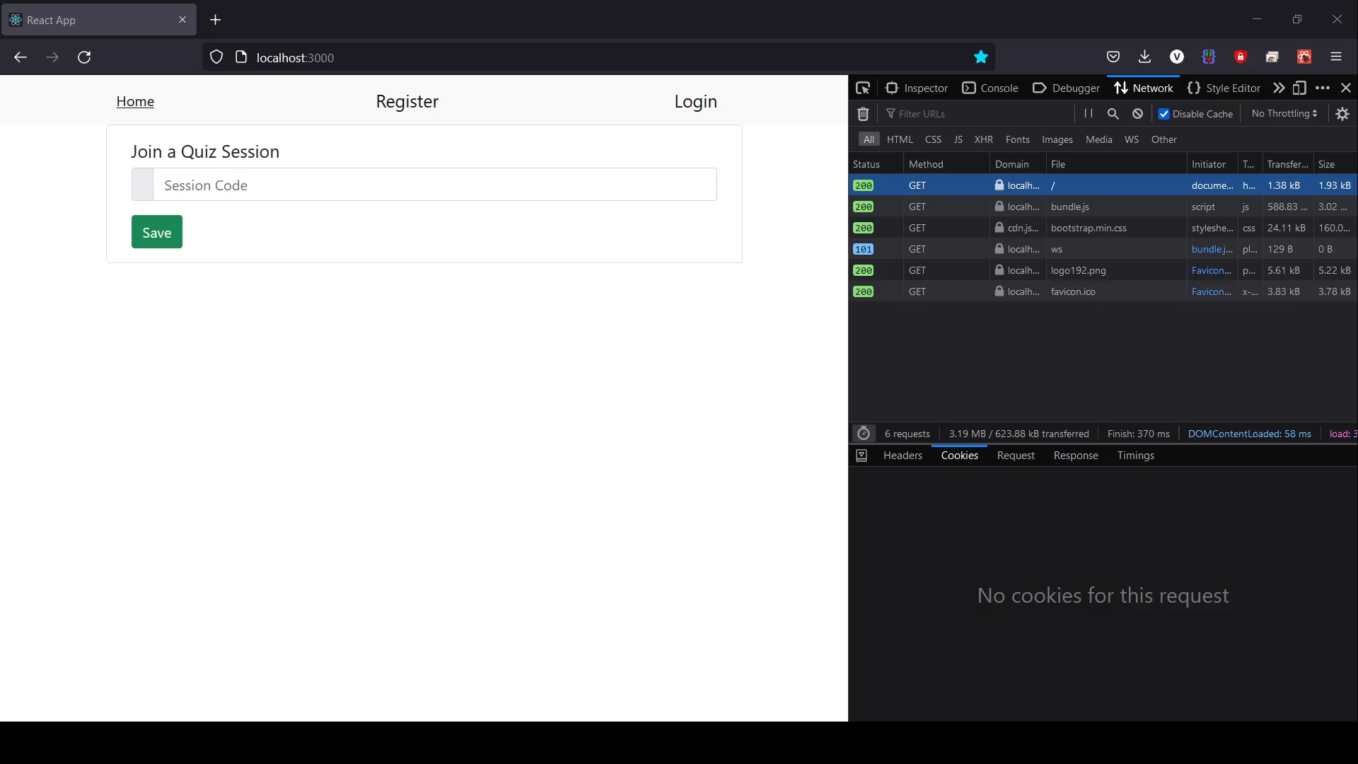
Application Login workflow

Slide 14
What next (June/July)
Project restructuring
Extra functionality
Final details
Week 14 &15
Week 18 &19
Week 16 &17
Improvements
Integration Tests

Slide 15
Q&A Thank You

